Slide 1
Ford-Fulkerson Algorithm
Victor Wu
Matt Price

Slide 2
Purpose
The Ford Fulkerson Algorithm computes the maximum flow in a flow network

Slide 3
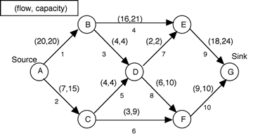
What is a flow network?
Directed graph with a source node and a sink node
Each edge has a flow and a capacity
Flow is amount of stuff that’s passed through network
Capacity is max flow that can pass through edge
Flow cannot exceed capacity

Slide 4
Applications of a flow network
Modeling traffic on the roads
Moving fluids through pipes
Moving currents in an electrical circuit
Essentially anything that travels through a network of nodes

Slide 5
Algorithm
Input
Given Network G =s (V, E) Flow capacity c, source node s, sink node t, path p
Output Time Complexity
ƒ(u, v) 0 ∀ (u, v) O(Edges * Max Flow)
∃p from s to t in G_{f} s.t. c_{f}(u,v) > 0 ∀ (u, v) ∈ p
c_{f}(p) = min { c_{f}(u, v) : (u, v) ∈ p }
∀ (u, v) ∈ p:
ƒ(u, v) ƒ(u, v) + c_{f}(p)
ƒ(v, u) ƒ(v, u) - c_{f}(p)
Notes:
Definitions
A directed network, or directed linear graph, G consists of a collection V of elements, x, y, etc. with a subset E of the ordered pairs (x, y) of elements taken from V. You may think of V as nodes, vertices, junction points, or points; while members of E are arcs, links, branches, or edges.
So we are given a graph G, a flow capacity, one source node, one sink node, and a path.
We start off by initializing the flow to be 0 for all edges. And while there is a path in Graph G where the capacity is greater than 0 for each edge, we calculate the very minimum capacity. The resulting residual graph can be computed by sending this flow in the opposite direction, and we subtract the current flow with this capacity.
We can either use a Breadth-First Search or a Depth-First Search. The variation of using a DFS is essentially the Edmonds-Karp algorithm which has a (E^2 * V) running time.

Slide 6
What is max flow in a flow network?
Max amount of anything you can move from starting point to a finish point
Often, in optimization theory, problems are single-source, single-sink

Slide 7
Finding max flow using Ford Fulkerson’s
Find the augmenting path, the path from source to sink
Compute the bottleneck capacity, the edge with smallest capacity in path
Augment each edge with the total flow
A flow has max flow if there are no augmenting paths left

Slide 8
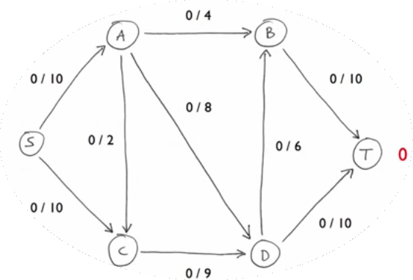
Notes:
We initialize all the flows to 0

Slide 9
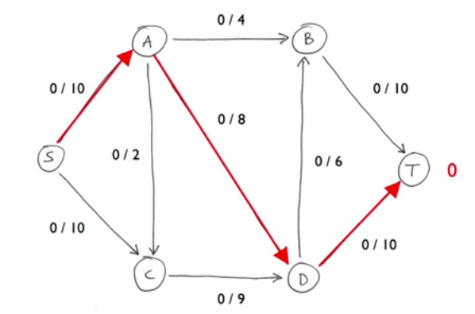
Notes:
We pick this path from source to sink, but any path can be picked

Slide 10
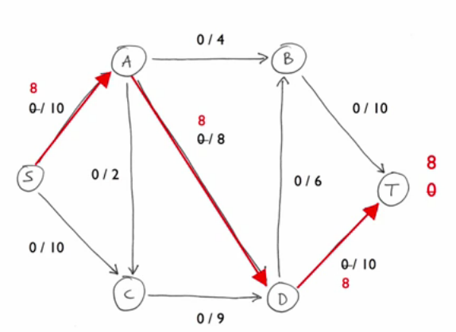
Notes:
We push 8 through every edge because A to D has a bottleneck capacity of 8

Slide 11
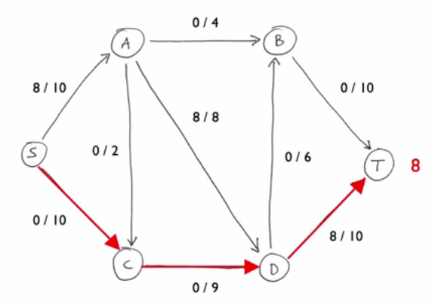
Notes:
We pick another augmenting path from source to sink

Slide 12
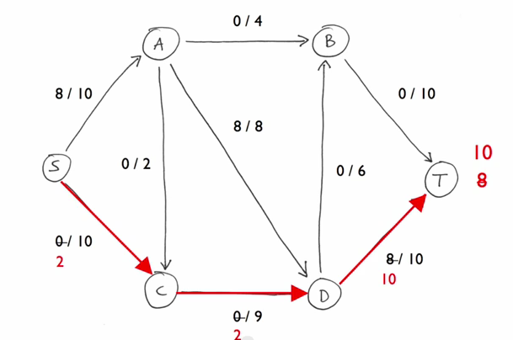
Notes:
Our bottleneck capacity here is 2 because we already pushed 8 from D to T and there is 2 left over. So we push 2 on each edge

Slide 13
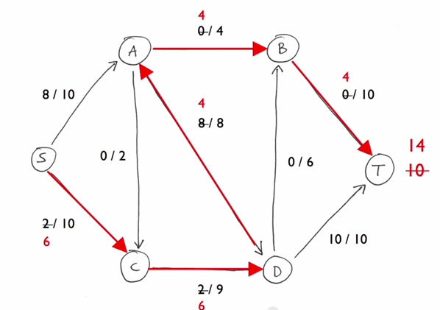
Notes:
In this path we take, the bottleneck capacity is 4 and we push 4 through every edge. Our max flow is now 14, but we still have augmenting paths so we continue

Slide 14
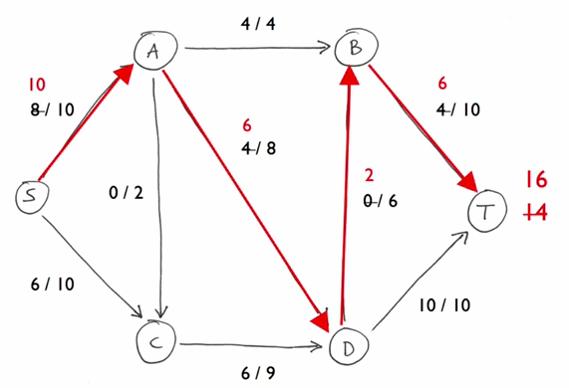
Notes:
Our bottleneck capacity is 2 now because we already pushed 8 out of 10 things from source to A. We push 2 down every edge on this path

Slide 15
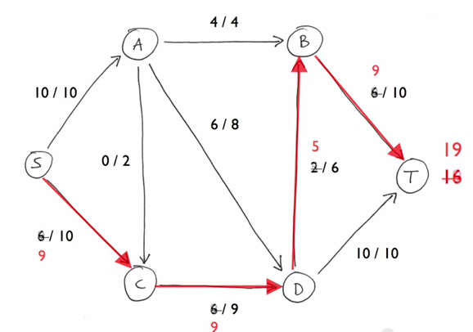
Notes:
We can push 3 here on this path because the capacity from C to D is 9, and 6 things have been pushed so far. Notice that no more things can be pushed because source to A is at full capacity and C to D is full capacity. We are done, and the max flow becomes 19 things pushed.

Slide 16
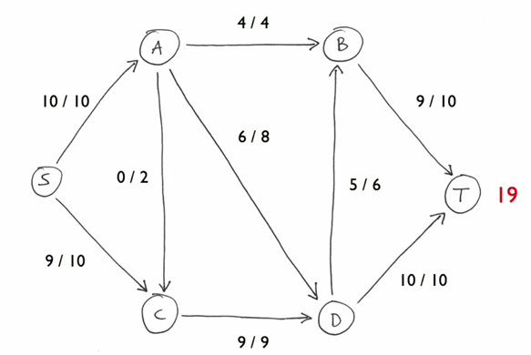

Slide 17
Implementation(pseudocode)
for each edge(u,v)
(u,v).f -> 0
while(BFS)
while there exists a path p from source s to sink t
min(u,v) = bottleneck capacity
for each edge (u,v)
(u,v).f <- (u,v).f + min(u,v)
(v,u).f <- (v,u).f + min(u,v)

Slide 18
Sources
Ford, L., & Fulkerson, D. (2010). Flows in networks. Princeton, N.J.: Princeton
University Press.
Ford–Fulkerson algorithm. (2015, November 11). In Wikipedia. Retrieved from
https://en.wikipedia.org/wiki/Ford–Fulkerson_algorithm

